Slide 1
DATA VISUALIZATION
LECTURE 3
10/03/2022

Slide 2
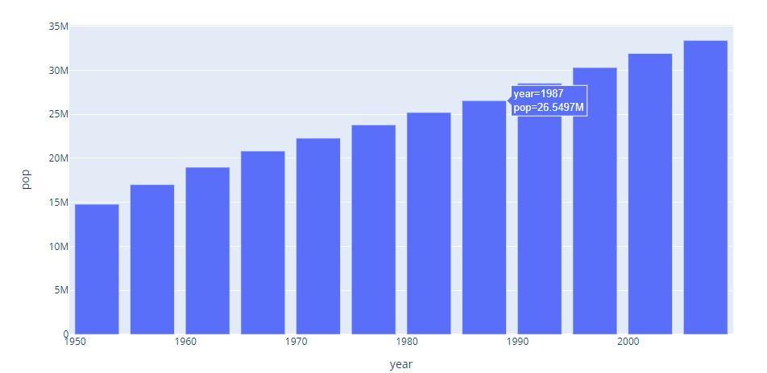
Bar Graph
A bar graph is a graph that presents categorical data with rectangle-shaped bars.
The heights or lengths of these bars are proportional to the values that they represent.
The bars can be vertical or horizontal. A vertical bar graph is sometimes called a column graph.

Slide 3
Types of data visualization
There are two basic types of data visualization: static and interactive.
Static visualizations are something like an infographic, a single keyhole view of a particular data story.
Interactive visualizations allow you to customize your story by moving a slider or clicking a button to enable various views of the dataset.

Slide 4
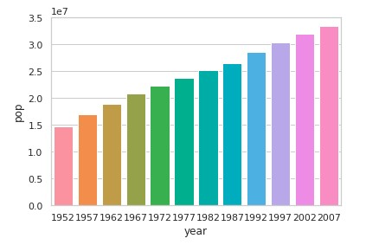
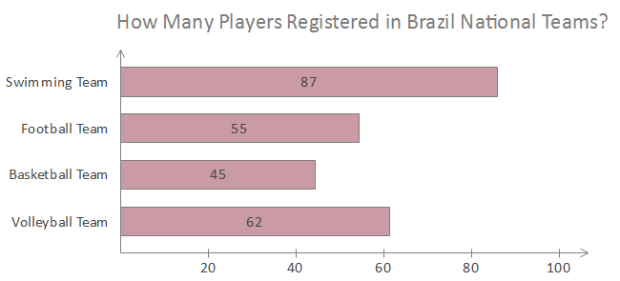
Bar-Graph

Slide 5
Grouped Bar Graph
Grouped bar graphs are used when the datasets have subgroups that need to be visualized on the graph.
The subgroups are differentiated by distinct colours. Here is an illustration of such a graph:

Slide 6
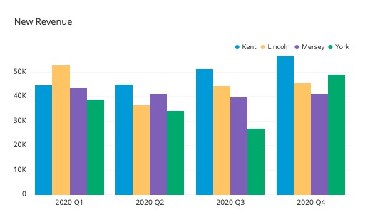
Grouped Bar Graph

Slide 7
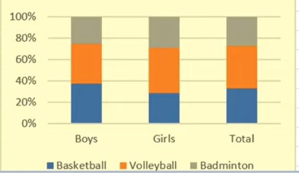
Segmented Bar Graph
This is the type of stacked bar graph where each stacked bar shows the percentage of its discrete value from the total value. The total percentage is 100%. Here is an illustration:

Slide 8
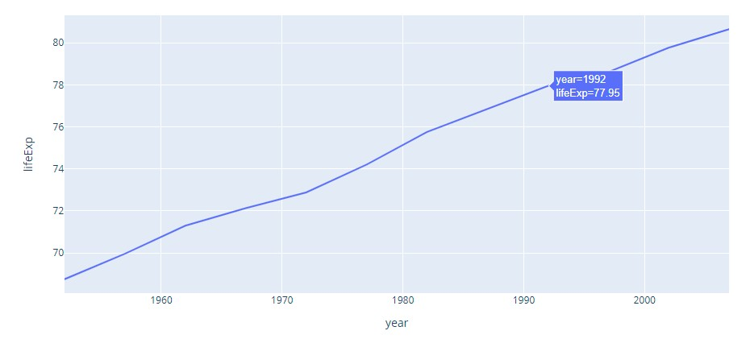
Line Graph
It displays a sequence of data points as markers. The points are ordered typically by their x-axis value. These points are joined with straight line segments. A line graph is used to visualize a trend in data over intervals of time.

Slide 9
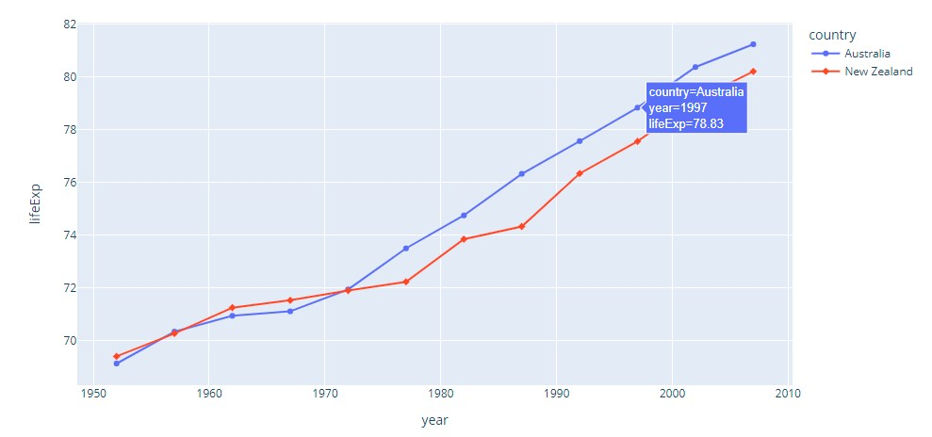
Multiple Line Graph

Slide 10
Pie Chart
A pie chart is a circular statistical graphic.
To illustrate numerical proportion, it is divided into slices. In a pie chart, for every slice, each of its arc lengths is proportional to the amount it represents.
The central angles, and area are also proportional. It is named after a sliced pie.

Slide 11
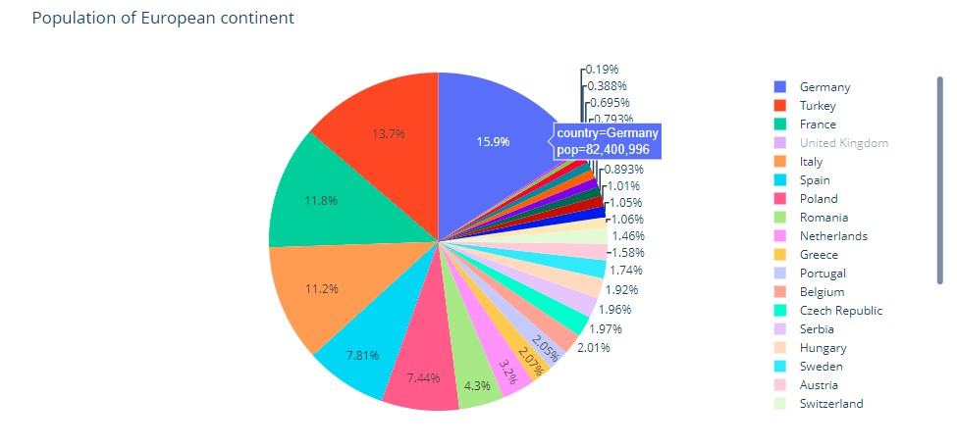
Pie Chart

Slide 12
Histogram
A histogram is an approximate representation of the distribution of numerical data.
The data is divided into non-overlapping intervals called bins and buckets.
A rectangle is erected over a bin whose height is proportional to the number of data points in the bin. Histograms give a feel of the density of the distribution of the underlying data.

Slide 13
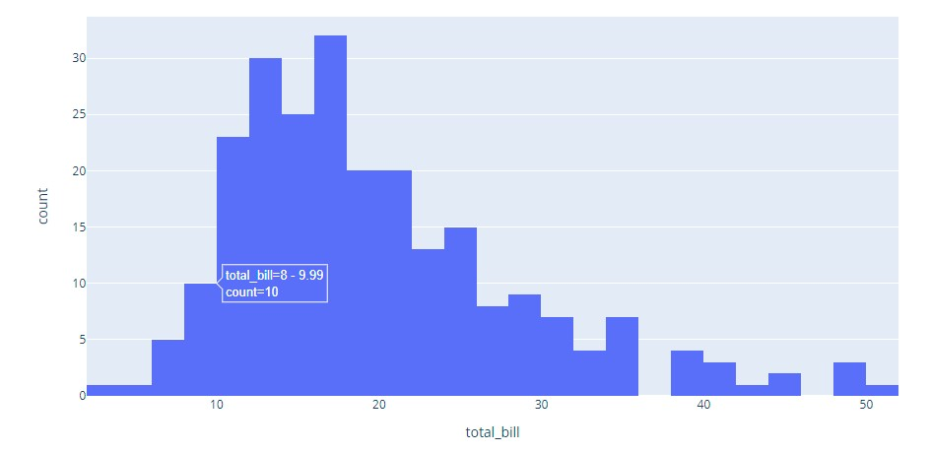
Histogram

Slide 14
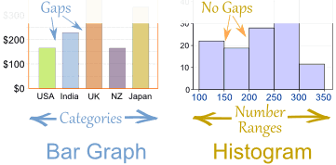
Bar Graphs vs Histogram

Slide 15
SCATTER PLOT
A scatter plot (aka scatter chart, scatter graph) uses dots to represent values for two different numeric variables.
The position of each dot on the horizontal and vertical axis indicates values for an individual data point.
Scatter plots are used to observe relationships between variables.

Slide 16
Outlier
In statistics, an outlier is a data point that differs significantly from other observations.
An outlier may be due to variability in the measurement or it may indicate the experimental error; the latter are sometimes excluded from the data set.

Slide 17
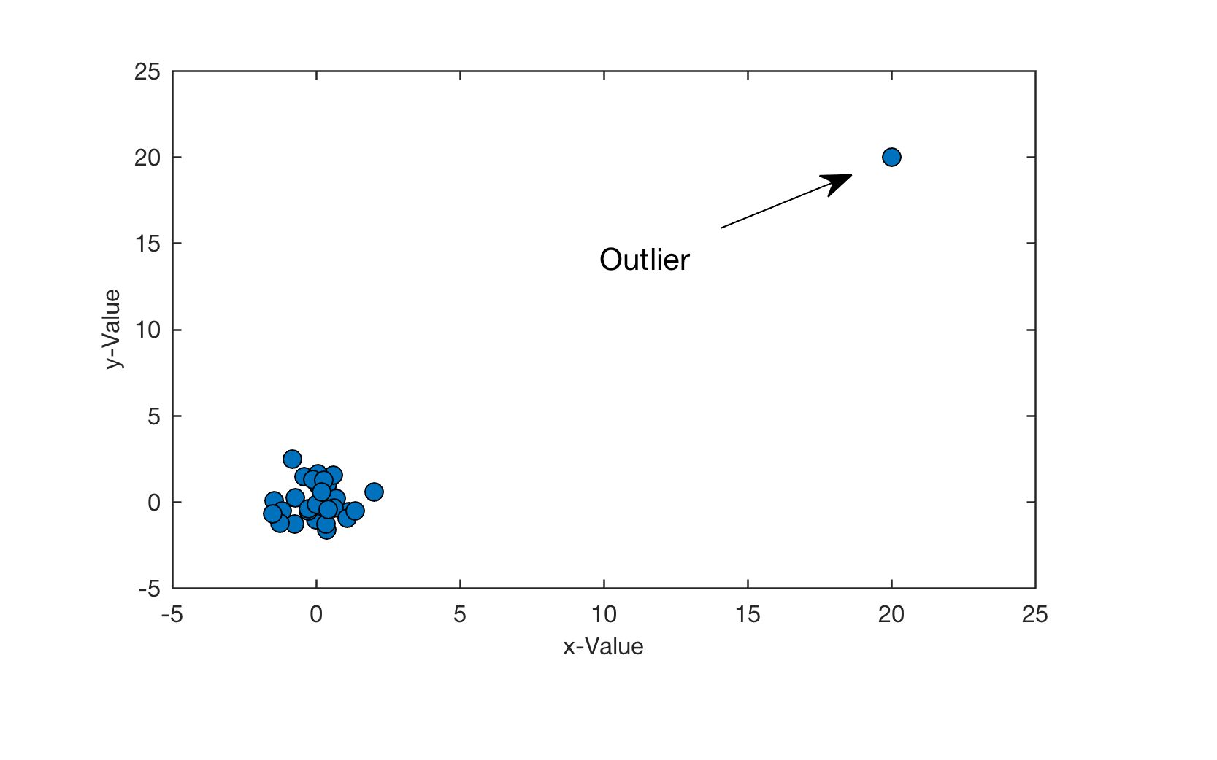
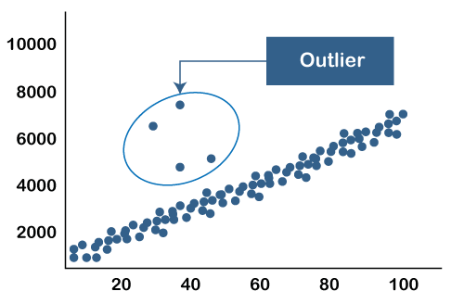
Outlier’s

Slide 18
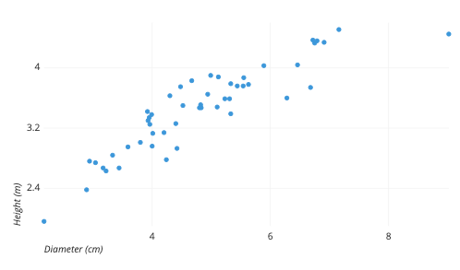
Scatter Plot
The example scatters plot above shows the diameters and heights for a sample of fictional trees.
Each dot represents a single tree; each point’s horizontal position indicates that tree’s diameter (in centimeters) and the vertical position indicates that tree’s height (in meters).
we can see a generally tight positive correlation between a tree’s diameter and its height.
We can also observe an outlier point, a tree that has a much larger diameter than the others. This tree appears fairly short for its girth, which might warrant further investigation.

Slide 19
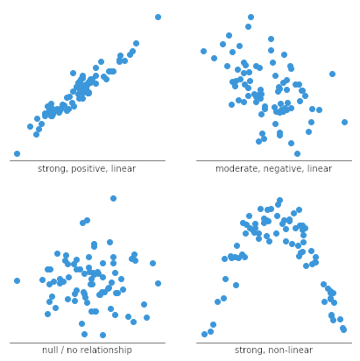
Analysis of Scatter Plot

Slide 20
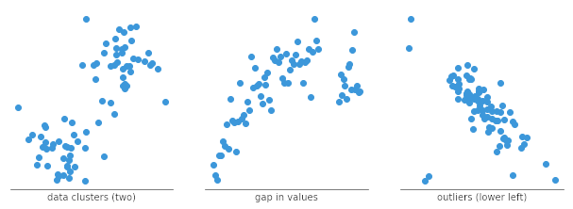
Analysis of Scatter Plots

Slide 21
When You should use Scatter Plots
Scatter plots’ primary uses are to observe and show relationships between two numeric variables.
The dots in a scatter plot not only report the values of individual data points but also patterns when the data are taken as a whole.
Identification of correlational relationships are common with scatter plots.

